Slide 1

- Workflow Management System
AIRFLOW

Slide 2
Training References
Airflow - https://airflow.apache.org/docs/stable/

Slide 3

AWS Training - Legends
Information
LAB
3
Out-of-Scope Information

Slide 4
Airflow and Workflow
Airflow is a platform to programmatically author, schedule and monitor workflows or data pipelines
Workflow:
A sequence of Tasks
Started on a Schedule or Triggered by an event
Frequently used to handle big data processing pipelines
Download data from source.
Send data somewhere else to process.
Monitor when the process is completed.
Get the result and generate the support.
Send the report out by email
Download_data
Send_data_to_processing
Monitor_processing
Generate_report
Send_email

Slide 5
Airflow
A workflow (data-pipeline) Management system developed by Airbnb
A framework to define tasks and dependencies in python
Executing , Scheduling , disturbing tasks across worker nodes.
View of present and past runs , logging feature
Extensible through plugins
Nice UI , possibility to define REST interface
Interact well with database

Slide 6
Airflow- Cont
Can handle upstream and downstream dependencies gracefully (Example : Upstream missing tables)
Easy to reprocess historical jobs by date or re - run for specific intervals.
Jobs can pass parameters to other jobs Downstream
Handle errors and failures gracefully. Automatically retry when a task fails.
Ease of deployment of workflow changes (continuous integration)
Integrations with a lot of infrastructure(hive , Presto , Druid , AWS , etc)
Data Sensors to trigger a DAG when data arrives
Job testing through airflow itself
Accessibility of log files and other meta-data through the web GUI
Implement triggers rules of tasks.
Monitoring of all jobs status in real time + EMAIL alerts
Community Support.

Slide 7
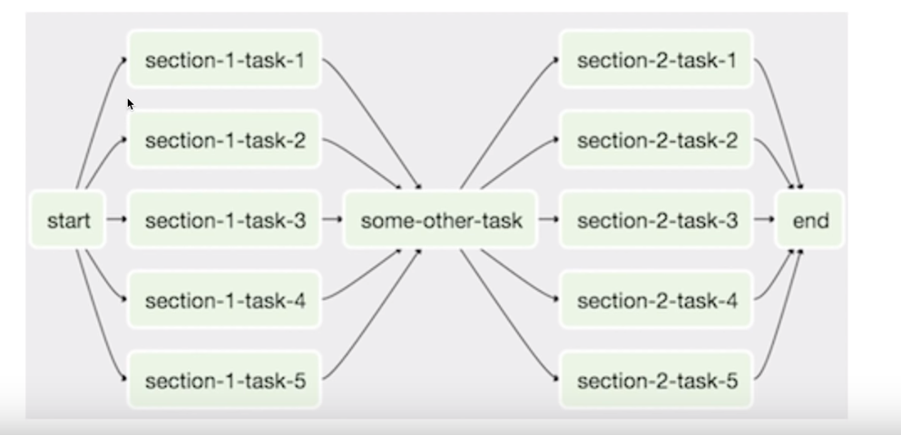
Airflow DAG
A Workflow as a Directed Acyclic Graph with Multiple tasks which can be executed independently
Airflows DAG’S are Composed of Tasks

Slide 8
Core Components
Web server
Scheduler
Metadata Database
Executor
Worker

Slide 9
Key Concepts
DAG
A graph object representing your data pipeline
Operator
Describe a single task in your data pipeline
Task
An instance of an operator
TaskInstance
Represents a speciﬁc run of a task = DAG + TASK + POINT IN TIME
Workﬂow
Combination of all above

Slide 10
What Airﬂow brings you?
Pipelines developed in Python.
Graphical representation of your DAGs..
Airﬂow is scalable.
Catchup and Backﬁll
Very extensible.
And much more ...

Slide 11
Airflow Architecture Overview for Single Node
Queueing System
Is part of executors
Node
Executor
(1 - n)
Scheduler
Web Server
Metastore DB

Slide 12
Airflow Architecture Overview for Multi Nodes
Queueing System
Becomes an external queue component ( RabbitMQ )
Worker Node 1
Worker Node 2
Worker Node N
Master Node
Executor (1 - N)
Executor (1 - N)
Executor (N)
Scheduler
Web Server
...
Metastore DB
Worker Node ≠ Worker (process)

Slide 13
How Airflow Works?
The Scheduler reads the DAG folder.
Your DAG is parsed by a process to create a DagRun based on the scheduling parameters of your DAG.
A TaskInstance is instantiated for each Task that needs to be executed and ﬂagged to “Scheduled” in the metadata database.
The Scheduler gets all TaskInstances ﬂagged “Scheduled” from the metadata database, changes the state to “Queued” and sends them to the executors to be executed.
Executors pull out Tasks from the queue ( depending on your execution setup ), change the state from “Queued” to “Running” and Workers start executing the TaskInstances.
When a Task is ﬁnished, the Executor changes the state of that task to its ﬁnal state (success, failed, etc) in the database and the DAGRun is updated by the Scheduler with the state “Success” or “Failed”. Of course, the web server periodically fetch data from the metadatabase to update the UI.

Slide 14
How Your Work Gets Done?
Dag?
Queueing System
Dag Folder
Executor (1 - n)
Scheduler
Web Server
Metastore DB
n - worker (process)

Slide 15
How Your Work Gets Done - Cont?
Queueing System
Dag Folder
Executor (1 - n)
Scheduler
Web Server
Create a Dagrun in DB
Metastore DB
DagRun
 | Running

Slide 16
How Your Work Gets Done - Cont?
Queueing System
Dag Folder
Executor (1 - n)
Scheduler
Web Server
Schedule
TaskInstances to run
Metastore DB
DagRun
 | Running
TaskInstance
 | Schedule | d

Slide 17
How Your Work Gets Done - Cont?
TaskInstance
 | Queued
Queueing System
Dag Folder
Send Task Instance
Executor (1 - n)
Scheduler
Web Server
Metastore DB
DagRun
 | Running
TaskInstance
 | Queued
Send Task Instance

Slide 18
How Your Work Gets Done - Cont?
Queueing System
Dag Folder
Executor Pulls out
TaskInstance
Executor (1 - n)
Scheduler
Web Server
Worker Executing The
TaskInstance
TaskInstance
Metastore DB
DagRun
 | Running
TaskInstance
 | Running
^{Executor Updates}
Running
^{The Task Instance}

Slide 19
How Your Work Gets Done - Cont?
Queueing System
Dag Folder
Executor (1 - n)
Scheduler
Web Server
TaskInstance
Success
Metastore DB
DagRun
 | Running
TaskInstance
 | Success
Executor Updates The
TaskInstance

Slide 20
How Your Work Gets Done - Cont?
Queueing System
Dag Folder
Executor (1 - n)
Scheduler
Web Server
Metastore DB
DagRun
 | Success
TaskInstance
 | Success
Work Done?

Slide 21
How Your Work Gets Done - Cont?
Queueing System
Dag Folder
Executor (1 - n)
Scheduler
Web Server
Update UI
Metastore DB
DagRun
TaskInstance
 | Success
Success

Slide 22
Airflow’s Architecture
Airflow is simply a queuing system built on top of a metadata database.
The database stores the state of queued tasks and a scheduler uses these states to prioritize how other tasks are added to the queue.
This functionality is orchestrated by four primary components
Metadata Database:
This database stores information regarding the state of tasks
Database updates are performed using an abstraction layer implemented in SQLAlchemy
This abstraction layer cleanly separates the function of the remaining components of Airflow from the database.

Slide 23
Airflow’s Architecture-cont
Scheduler:
The Scheduler is a process that uses DAG definitions in conjunction with the state of tasks in the metadata database to decide which tasks need to be executed, as well as their execution priority
The Scheduler is generally run as a service.
Executor:
The Executor is a message queuing process that is tightly bound to the Scheduler and determines the worker processes that actually execute each scheduled task.
There are different types of Executors, each of which uses a specific class of worker processes to execute tasks.
For example, the LocalExecutor executes tasks with parallel processes that run on the same machine as the Scheduler process.
Other Executors, like the CeleryExecutor execute tasks using worker processes that exist on a separate cluster of worker machines.

Slide 24
Airflow Executors
LocalExecutor:
Running Apache Airflow on a LocalExecutor exemplifies single-node architecture.
The LocalExecutor completes tasks in parallel that run on a single machine (think: your laptop, an EC2 instance, etc.) - the same machine that houses the Scheduler and all code necessary to execute.
A single LocalWorker picks up and runs jobs as they’re scheduled and is fully responsible for all task execution.
Summary:
It's straightforward and easy to set up
It's cheap and resource light
It still offers parallelism

Slide 25
Airflow Executors
CeleryExecutor
Celery itself is a way of running python processes in a distributed fashion. To optimize for flexibility and availability, the CeleryExecutor works with a "pool" of independent workers across which it can delegate tasks, via messages.
On Celery, your deployment's scheduler adds a message to the queue and the Celery broker delivers it to a Celery worker (perhaps one of many) to execute.
If a worker node is ever down or goes offline, the CeleryExecutor quickly adapts and is able to assign that allocated task or tasks to another worker.
Summary
High availability
Built for horizontal scaling
Worker Termination Grace Period (on Astronomer)

Slide 26
Airflow Executors
Kubernetes Executor:
The fresh-off-the-press Kubernetes Executor leverages the power of Kubernetes for ultimate resource optimization.
New to Airflow 1.10, the Kubernetes Executor relies on a fixed single Pod that dynamically delegates work and resources.
For each and every task that needs to run, the Executor talks to the Kubernetes API to dynamically launch an additional Pod, each with its own Scheduler and Webserver, which it terminates when that task is completed.
Summary:
Cost and resource efficient
Fault tolerant
Task-level configurations
No interruption to running tasks if a deploy is pushed

Slide 27
Airflow Executors
Sequential Executor:
The Sequential Executor runs a single task instance at a time in a linear fashion with no parallelism functionality (A → B → C).
It does identify a single point of failure, making it helpful for debugging.
Otherwise, the Sequential Executor is not recommended for any use cases that require more than a single task execution at a time.

Slide 28
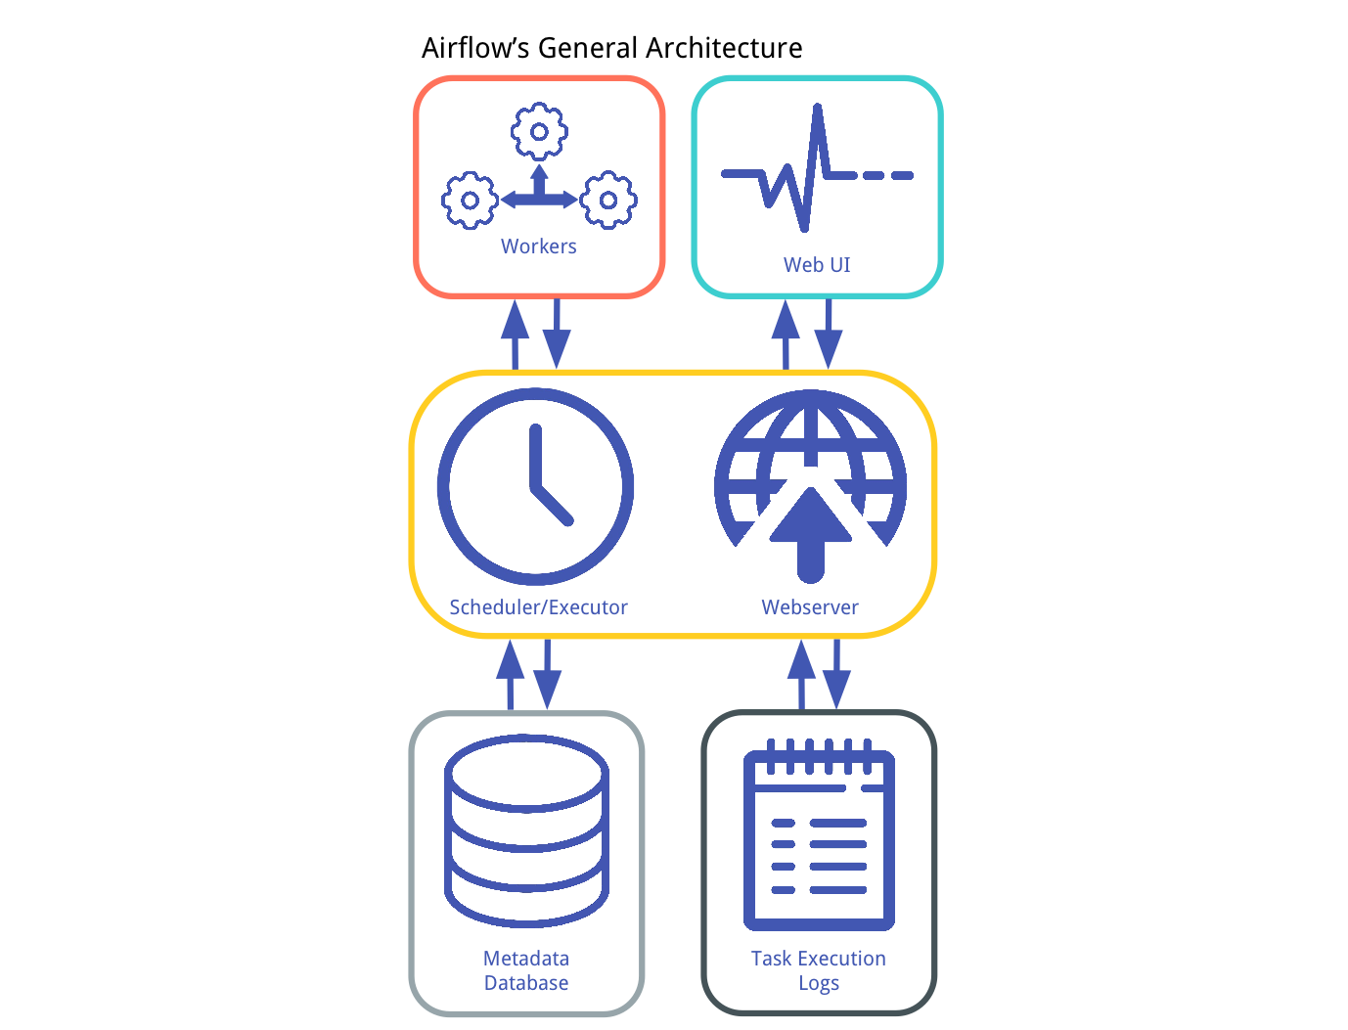
Airflow’s Architecture-cont
Workers: These are the processes that actually execute the logic of tasks, and are determined by the Executor being used.

Slide 29
Operators and its Key Points
An operator represents a single, ideally idempotent, task. Operators determine what actually executes when your DAG runs.
Deﬁnition of a single task
Should be idempotent
Meaning your operator should produce the same result regardless of how many times it is run.
Retry automatically
In case of a failure
A Task is created by instantiating an Operator class.
An Operator deﬁnes the nature of this Task and how should it be executed.
When an Operator is instantiated, this task becomes a node in your DAG.

Slide 30
Airﬂow Provide Many Operators
BashOperator
Executes a bash command
PythonOperator
Calls an arbitrary Python function
EmailOperator
Sends an email
MySqlOperator, SqliteOperator, PostgreOperator…
Executes a SQL command

Slide 31
Types of Operators
All Operators inherit from BaseOperator.
There are actually 3 types of operators:
Action operators that perform an action (BashOperator, PythonOperator, EmailOperator ...)
Transfer operators that move data from one system to another (PrestoToMysqlOperator, SftpOperator ...)
Sensor operators waiting for data to arrive at a deﬁned location.

Slide 32
Transfer Operators
Operators that move data from one system to another.
Data will be pulled out from the source, staged on the machine where the executor is running, and then transferred to the target system.
Don’t use these operators if you are dealing with a large amount of data.

Slide 33
Sensor Operators
Sensor operators inherit of BaseSensorOperator (BaseOperator being the superclass of BaseSensorOperator)
They are useful for monitoring external processes like waiting for ﬁles to be uploaded in HDFS or a partition appearing in Hive.
They are basically long running task.
The Sensor Operator has a poke method called repeatedly until it returns True ( it is the method used for monitoring the external process )

Slide 34

PIPELINE
Airflow Python script is really just a configuration file specifying the DAG’s structure as code.
The actual tasks defined here will run in a different context from the context of this script.
Different tasks run on different workers at different points in time, which means that this script cannot be used to cross communicate between tasks.
The script’s purpose is to define a DAG object
It needs to evaluate quickly (seconds, not minutes) since the scheduler will execute it periodically to reflect the changes if any

Slide 35
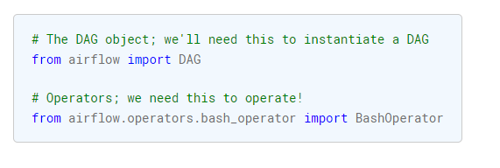
PIPELINE - Cont
Importing Modules:
An Airflow pipeline is just a Python script that happens to define an Airflow DAG object. Let’s start by importing the libraries we will need.
We use From airflow import DAG to instantiate a DAG.
We need Operators so from airflow . operators . bash _ operator import Bash0perator

Slide 36
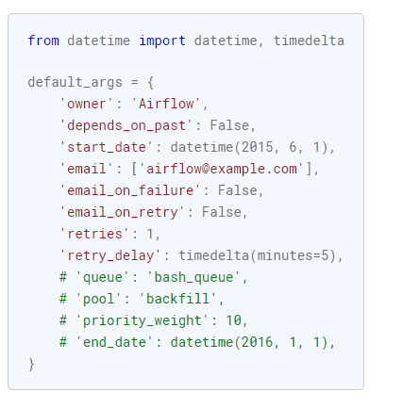
PIPELINE - Cont
Default Arguments:
We’re about to create a DAG and some tasks.
we have the choice to explicitly pass a set of arguments to each task’s constructor (which would become redundant), or (better!)
we can define a dictionary of default parameters that we can use when creating tasks.
Also, note that you could easily define different sets of arguments that would serve different purposes.
An example of that would be to have different settings between a production and development environment

Slide 37
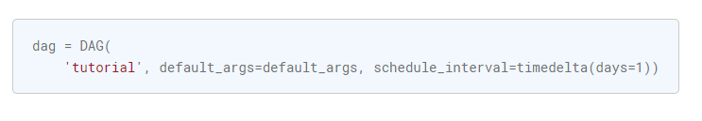
PIPELINE - Cont
Instantiate a DAG:
We’ll need a DAG object to nest our tasks into
Here we pass a string that defines the DAG _ id,
Which serves as a unique identifier for your DAG
We also pass the default argument dictionary that we just defined and define a schedule _ interval of 1 day for the DAG

Slide 38
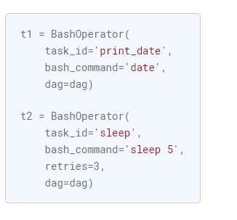
PIPELINE - Cont
Tasks
Tasks are generated when instantiating operator objects.
An object instantiated from an operator is called a constructor.
The first argument task _ id acts as a unique identifier for the task

Slide 39
PIPELINE - Cont
We pass a mix of operator specific arguments (bash _ commands) and an argument common to all operators inherited from BaseOperator to the operator’s Constructor
This is simpler than passing every argument for every Constructor call
Also notice that in the second task we override the retries parameter with 3
The precedence rules for a task as follows:
Explicitly passed arguments
Values that Exist in the default _ args dictionary.
The operator’s default value, if one exists
A task must include or inherit the arguments task_id and owner, otherwise airflow will raise an exception.

Slide 40
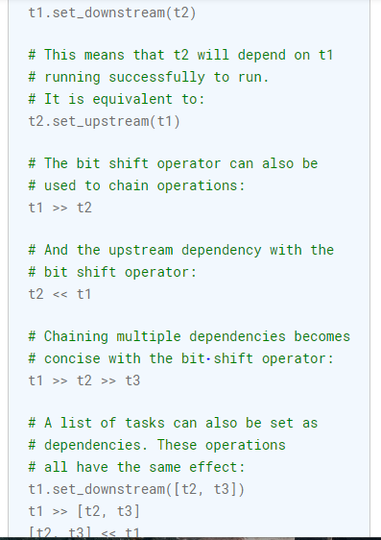
PIPELINE - Cont
Setting up Dependencies:
We have tasks t1 , t2 , t3 that do not depend on each other .Few ways you can define dependencies between them:
Note that when executing your script,
Airflow will raise exceptions when it finds cycles in your DAG
or when a dependency is referenced more than once.

Slide 41
Thank You

